Slide 1

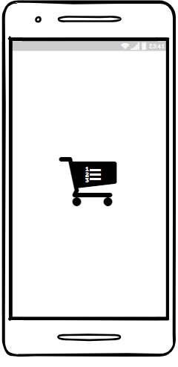
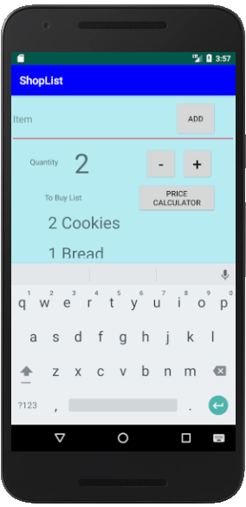
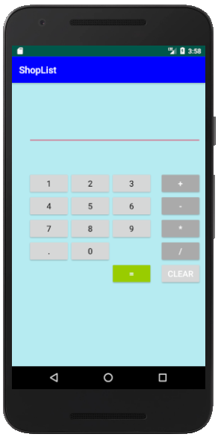
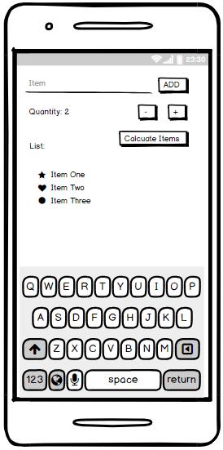
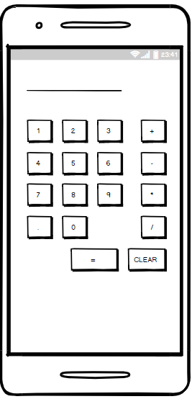
ShopList Application
Introduction
This image of the main page of the application that has been implemented, all of the functions are working. The quantity of a item can be changed. Also the swipe to delete function is correctly deploying.
The ShopList Application is designed and implemented on android studio. This application allows users to add shopping items to a list, users can also calculate how much they may need to spend. Before a user can add shopping items they will need to determine the quantity needed. Once user wants to delete items they can by swiping to the right. This mobile application will also include a calculator feature which is helpful as it helps the users to work out track how much they are spending.
This wireframe contains the a design of the splash screen that has will be implement for this application. This includes a logo.
Methods
Android Studio – this is the official IDE (Integrated Development Environment) base on IntelliJ IDEA which is used to create android applications. This was used to create ShopList application. (Android Developers, 2019).
SQLite – This is a opensource that stores data on a text file on to a device. [1] This is used in ShopList application to store shopping item s entered by the user. (Android Developers, 2019).
Relative Layout – This is a view group that allows positions to be relative to siblings elements e.g. left-of. (Android Developers, 2019) .This view group is used for both pages.
Recycle View – The list is created on a RecycleView as this is more flexible then a ListView as it helps features such as scrolling and swipe to delete which is a feature on the ShopList application. (Android Developers, 2019).
This image is for the second page of the application, this is deployed by the ‘price calculator’ button in the main page. The calculator is functional and works out sums appropriately.
This is a wireframe of the main page for the ‘ShopList’ application. This shows designs of how the applications user interface will appear and gives the implementer a structure.
Conclusion
This application was enjoyable to make as the idea was created from personal experience. There were a few problems with swipe to delete and android studio developed some bugs during implementation. However those problems were overcome and the app is fully functional.
Results
References
A wireframe for the second page of the application has also being created which will appear on click of a button from the user.
The result of creating this application was successful with the methods that have been used. The applications functionality is functioning, this includes connection of a database to store data, adding quantity to lists entries, all use of button working properly include the calculator answering correct sums. This application also allows swipe to delete.
Android Developers. (2019). Meet Android Studio | Android Developers. [online] Available at: https://developer.android.com/studio/intro/ [Accessed 6 Jan. 2019].
Android Developers. (2019). Relative Layout | Android Developers. [online] Available at: https://developer.android.com/guide/topics/ui/layout/relative [Accessed 6 Jan. 2019].
Android Developers. (2019). RecyclerView | Android Developers. [online] Available at: https://developer.android.com/reference/android/support/v7/widget/RecyclerView [Accessed 6 Jan. 2019].
Android Developers. (2019). Save data using SQLite | Android Developers. [online] Available at: https://developer.android.com/training/data-storage/sqlite [Accessed 6 Jan. 2019].
By Keno Iberhysaj - 21529777

